Slide 1
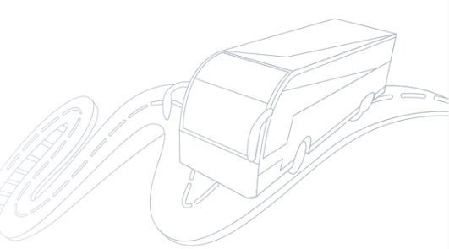

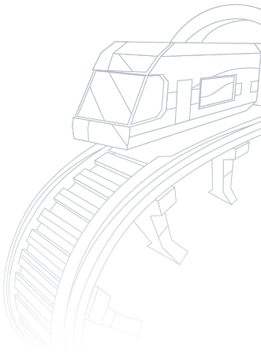
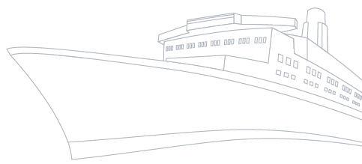


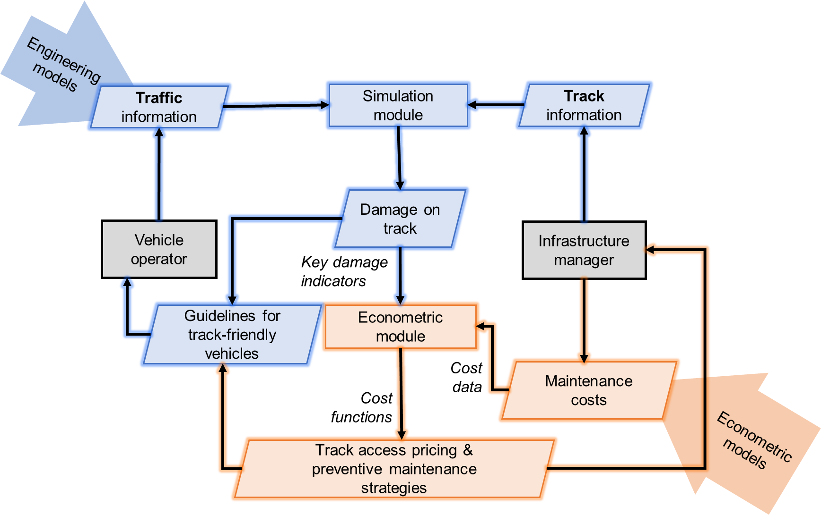
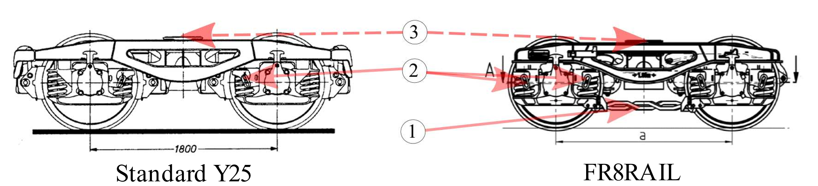
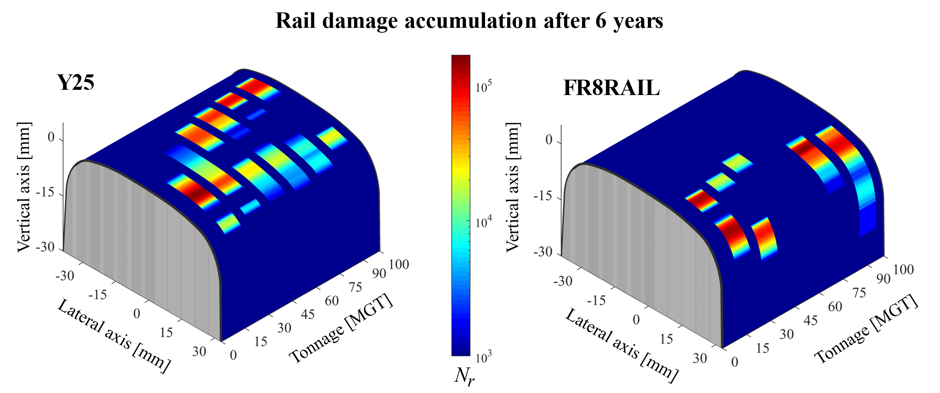
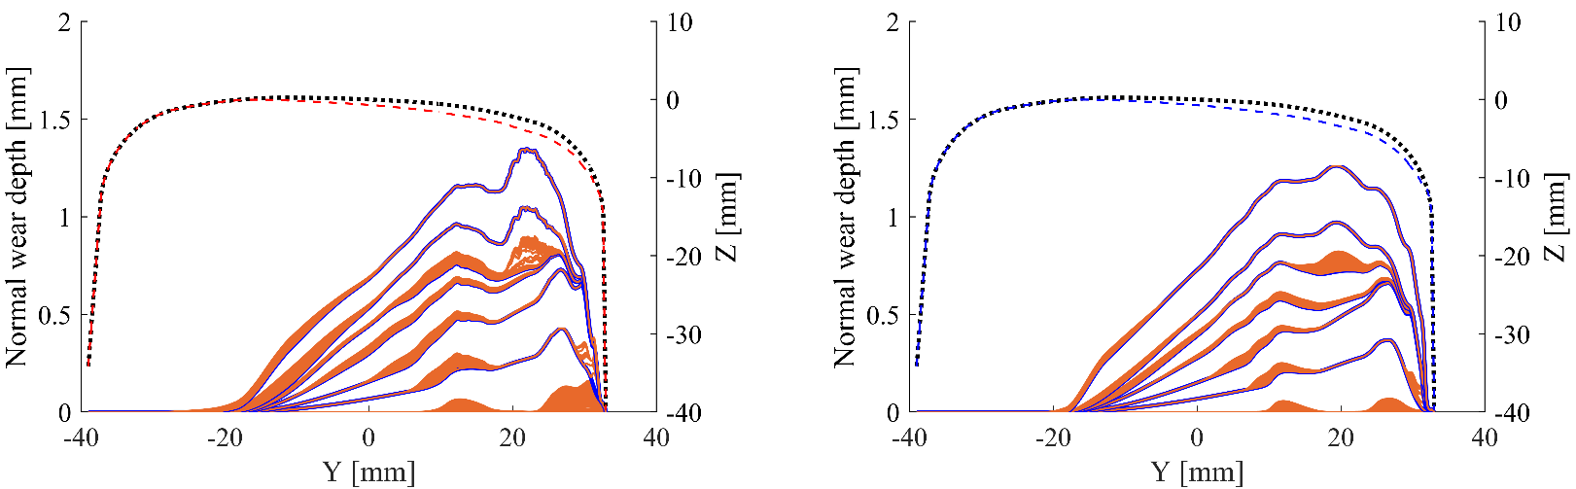

Track Friendliness 4.0
Key Characteristics
A system-wide methodology to determine track-friendliness of rail vehicles
Considers vehicle and track attributes along with maintenance operations to help deciding track-access pricing strategies.
Uses state-of-the-art engineering models to be coupled alongside econometric methods to determine cost functions using multi-domain simulations
Motivation & Objectives
Methodology
Increase the competetiveness of the rail transportation in the Single European Railway Area by developing new track-friendly bogie concepts.
Guide infrastructure managers to develop effective track-access pricing strategies based on the calculation of damage indicators for different track-vehicle combinations.
Help different stakeholders involved in the vehicle-track system with better maintenance planning w.r.t. various damage modes.
Framework to implement track friendliness 4.0
Results
Comparison of two bogie designs
FR8RAIL is a new variant of standard Y25 manufactured by Tatravagonka Poprad
Some distinguishing characteristics of the FR8RAIL bogie compared to the standard Y25 bogie are:
  Presence of cross-bracing links in the FR8RAIL bogie
  Presence of double Lenoir-links
  Lack of longitudinal clearance in sidebearer springs
Rolling Contact Fatigue damage
Fatigue accumulations before each grinding interval over 100 MGT passage
Lesser fatigue accumulations at each grinding interval for the FR8RAIL running gear while compared to the standard design.
The potential of tailoring the track maintenance strategy w.r.t the type of vehicle on it to gain savings in maintenance.
Key damage indicators
The Cross section lost after 100 MGT of wagon passage acts as the key damage indicator for the damage on track due to rail surface damage
Blue lines refer to grinding operation and orange regions represent the material lost to wear by vehicle.
The key damage indicator includes the effect of the vehicle and an optimal maintenance strategy to evaluate track-friendliness.
Research Outlook
The key damage indicators and cost data with suitable econometric models for various damage mechanisms could even predict the impact on the vehicle-track system with the introduction of novel vehicle concepts or new maintenance strategies.
Visakh V Krishna - FSE Sverige Email: visakh@kth.se
KTH Royal Institute of Technology SE-10044 Stockholm, Sweden
The research work has been carried out under the framework of the Shift2Rail projects FR8RAIL (Grant no.730617) and FR8RAIL2 (Grant no.826206)

